Slide 1
Experience of indexing brain research related measurements with NIFSTD (More requirements than implementation)
Maryann Martone

Slide 2
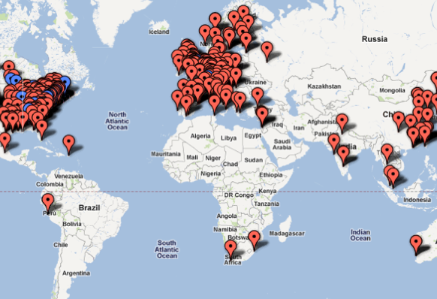
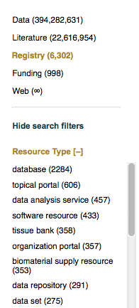
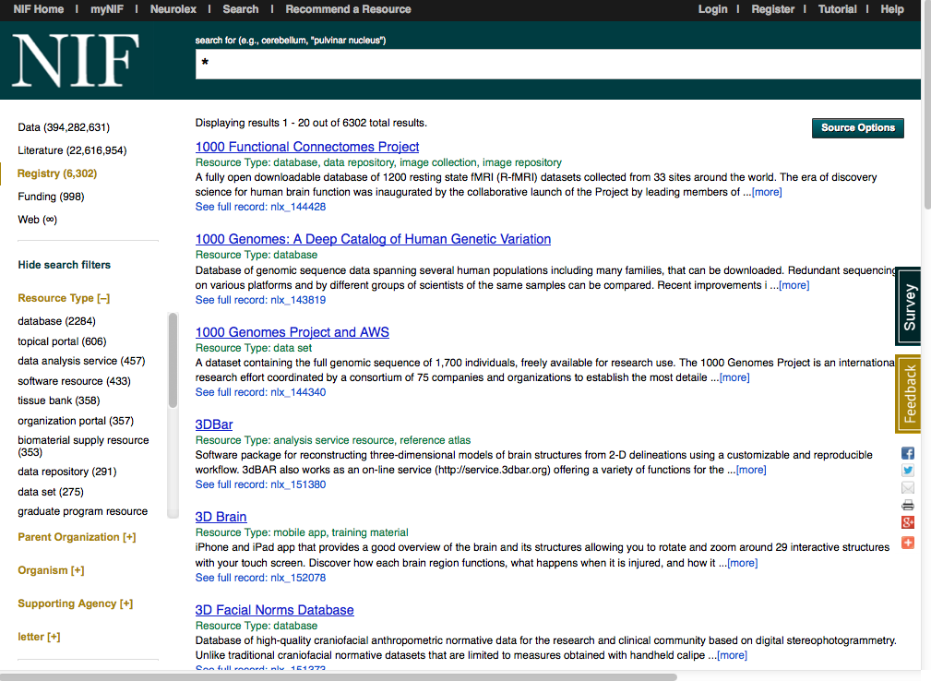
Surveying the resource landscape

Slide 3
Data sources come in different flavors
NIF favors a hybrid, tiered, federated system
Domain knowledge
Ontologies
Claims, models and observations
Virtuoso RDF triples
Model repositories
Data
Data federation
Spatial data
Workflows
Narrative
Full text access
Organism
Gene
Neuron
Brain part
Disease
Technique
People
Caudate projects to Snpc
Grm1 is upregulated in chronic cocaine
Betz cells degenerate in ALS

Slide 4
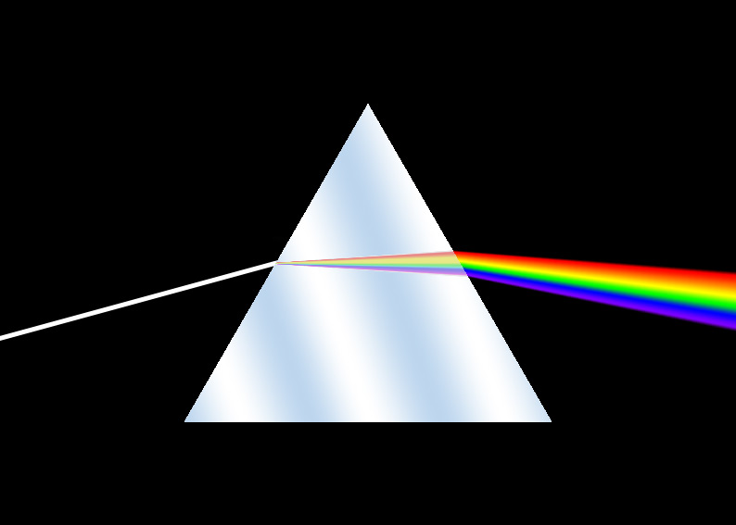
NIF Ontologies
Enhancing search across heterogeneous and evolving data
Exploratory searches: user has little idea of what is available and it changes all the time
Mitigate against lack of terminology standards
Concept-based search-integration through relations
Tool for NLP processing: Resource identification in literature
Annotation:
Entity mapping, Tagging NIF Registry, Literature
Organizational framework for NIF data
Basis of evolving NIF Knowledge Base
Provides the semantic framework for integrating sources and mapping the neuroscience resource landscape
Two prisms through which we view ontologies: search and efficiency

Slide 5
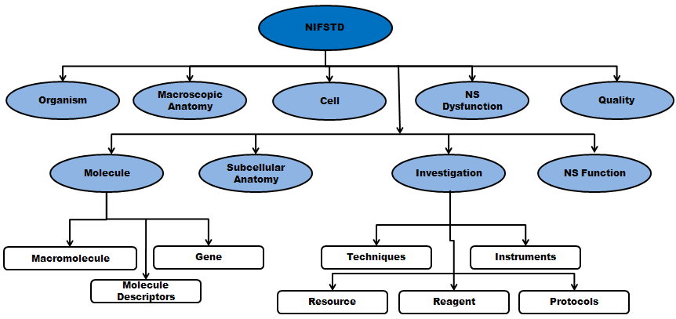
NIFSTD Ontologies
Set of modular ontologies
>90, 000 distinct concepts + synonyms
Expressed in OWL-DL language
Supported by common DL Reasoners
Currently supports OWL 2
Closely follows OBO community best practices
Avoids duplication of efforts
Standardized to the same upper level ontologies
e.g., Basic Formal Ontology (BFO), OBO Relations Ontology (OBO-RO),
Relies on existing community ontologies
e.g., CHEBI, GO, PRO, DOID, OBI etc.
Bill Bug, Fahim Imam
Available for download, through Bioportal and via NIF vocabulary services
Notes:
The NIFSTD ontologies are built in a modular fashion, where each module covers a distinct, orthogonal domain of neuroscience (Bug et al., 2008).
Modules covered in NIFSTD include anatomy, cell types, experimental techniques, nervous system function, small molecules and so forth.
NIFSTD modules are expressed in W3C standard Web Ontology Language Description Logic (OWL-DL) formalism.
Using OWL-DL, NIFSTD provides a balance between its expressivity and computational decidability. OWL-DL also allows the NIFSTD ontologies to be supported by a range of reasoners (DIG Group; such as Pellet and Fact++. NIFSTD utilizes these reasoners to maintain its inferred classification hierarchies as well as to keep its ontologies in a logically consistent state.
NIFSTD currently supports OWL 2, the latest ontology language advocated by the W3C consortium. OWL 2 has some improved ontological features such as defining property chain rules to enable transitivity across object properties, specifying reflexivity, asymmetry, and disjointness between object properties, richer data-types, qualified cardinality restrictions, and enhanced annotation capabilities.
NIFSTD closely follows the OBO Foundry best practices;
However, when it comes to community consensus, we take a practical approach, designed to easily extend the NIFSTD ontologies, while at the same time mitigating against any disruptions to the production NIF system.
The upper level classes in NIFSTD modules are normalized under the appropriate BFO entities.
Since the beginning, we recognized the significance of a formal ontology. As the number of biomedical ontologies increases, formal ontology like BFO plays an important role to promote semantic interoperability and data integration. Essentially BFO provides a logical basis to categorize the domain-independent high level classes, such as the entities, characteristics and processes. This kind of categorization helps to avoid erroneous and ambiguous ontological assertions, and it was necessary to develop a large-scale ontology like NIFSTD.

Slide 6
Importing into NIFSTD
NIF converts to OWL and aligns to BFO, if not already
Facilitates ingestion, but can have negative consequences for search if model adds computational complexity
Data sources do not make careful distinctions but use what is customary for the domain
Modularity: NIF seeks to have single coverage of a sub-domain
We are not UMLS or Bioportal
NIF uses MIREOT to import individual classes or branches of classes from large ontologies
NIF retains identifier of source
NIF uses ID’s for names, not text strings
Avoids collision
Allows retiring of class without retiring the string
NIFSTD has evolved as the ontologies have evolved; had to make many compromises based on ontologies and tools available

Slide 7
“Bridge files”
Anatomy
Cell Type
Cellular
Component
Small
Molecule
CNS
Neuron
Neuro-
transmitter
Transmembrane
Receptor
Purkinje
Cell
Dentate
Nucleus
Neuron
Expressed in
GABA
GABA-R
Cytoarchitectural
Part of
Cerebellar Cortex
Cpllection of
Deep Cerebellar
Nuclei
Presynaptic
density
Terminal Axon
Bouton
Purkinje
Cell Layer
Dentate
Nucleus
Transmitter
Vesicle
Located in
Cross module relationships and neuroscience-specific content are developed by NIF

Slide 8
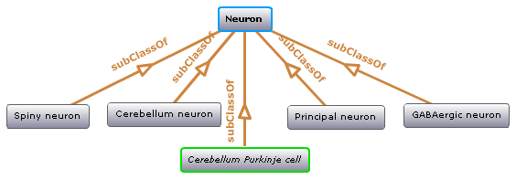
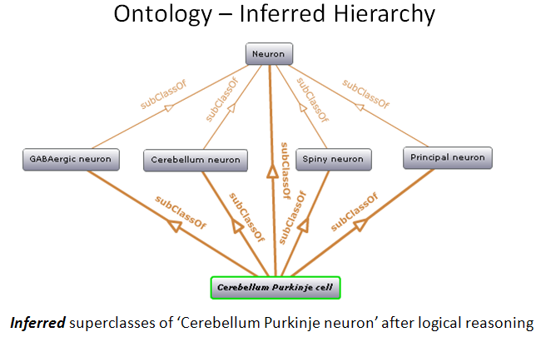
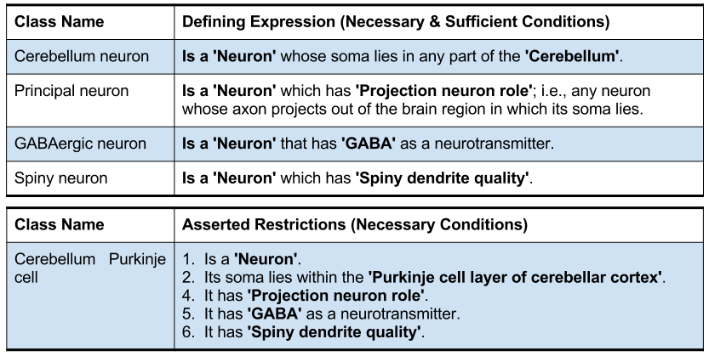
Example Use case: Neuron types Classification

Slide 9
OntoQuest
A scalable ontology management system that allows deep searching of multiple OWL and OBO ontologies and their intermappings
Very fast hierarchical search through and any (subclasses, part-of, located-in...) hierarchical (DAG-like) relationships
Implements various graph search algorithms for ontological graphs
Pre-computes equivalent classes
Query expansion based on Boolean operators and ontology rules
Synonyms, equivalent classes
Suppresses upper level ontology terms
Both a Java API and a REST service API
Searching for concepts
Partial search for autocompletion, search through properties and search by definition
Searching for concept neighborhoods
Amarnath Gupta, Xufei Qian

Slide 10
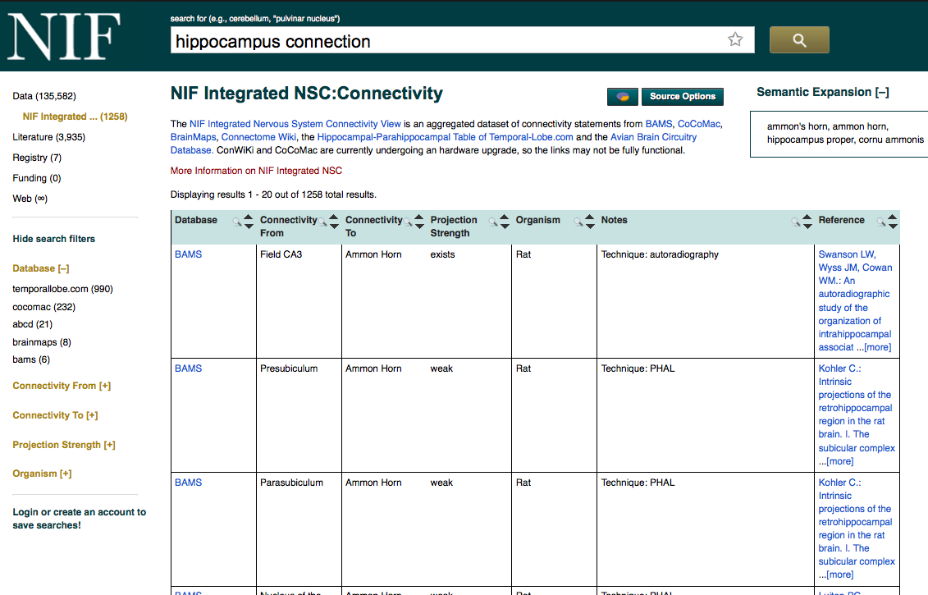
Inside the federation: What are the connections of the hippocampus?
Hippocampus OR “Cornu Ammonis” OR “Ammon’s horn”
Query expansion: Synonyms and related concepts
Boolean queries
Data sources categorized by “data type” and level of nervous system
Tutorials for using full resource when getting there from NIF
Common views across multiple sources
Link back to record in original source

Slide 11
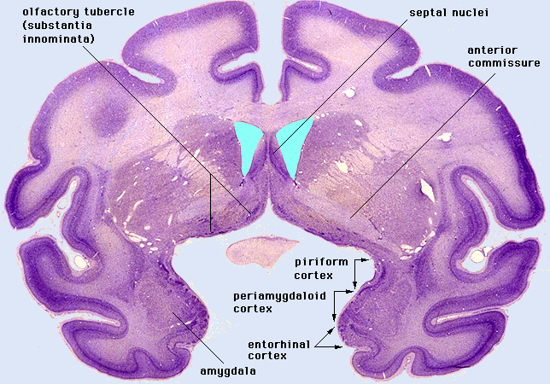
Ontologies as a data integration framework
NIF Connectivity: 7 databases containing connectivity primary data or claims from literature on connectivity between brain regions
Brain Architecture Management System (rodent)
Temporal lobe.com (rodent)
Connectome Wiki (human)
Brain Maps (various)
CoCoMac (primate cortex)
UCLA Multimodal database (Human fMRI)
Avian Brain Connectivity Database (Bird)
Total: 1800 unique brain terms (excluding Avian)
Number of exact terms used in > 1 database: 42
Number of synonym matches: 99
Number of 1st order partonomy matches: 385
NIF is currently re-implementing the ability to add parts to queries

Slide 12
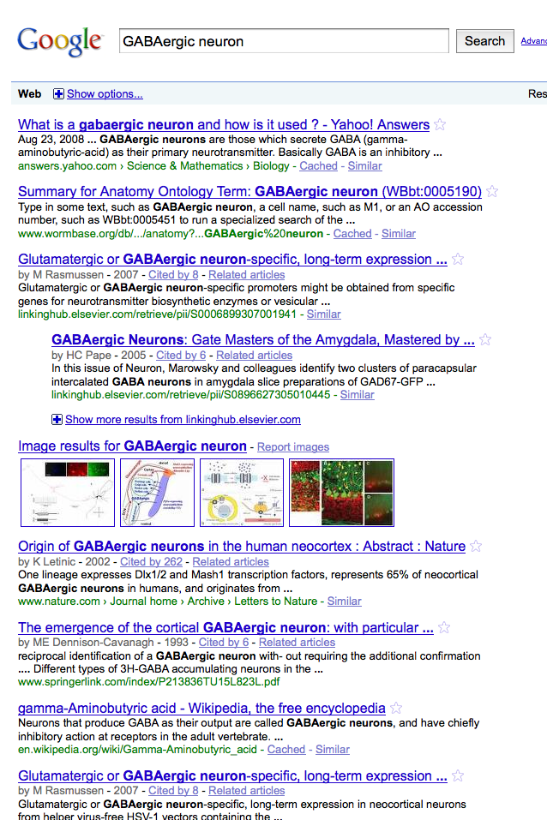
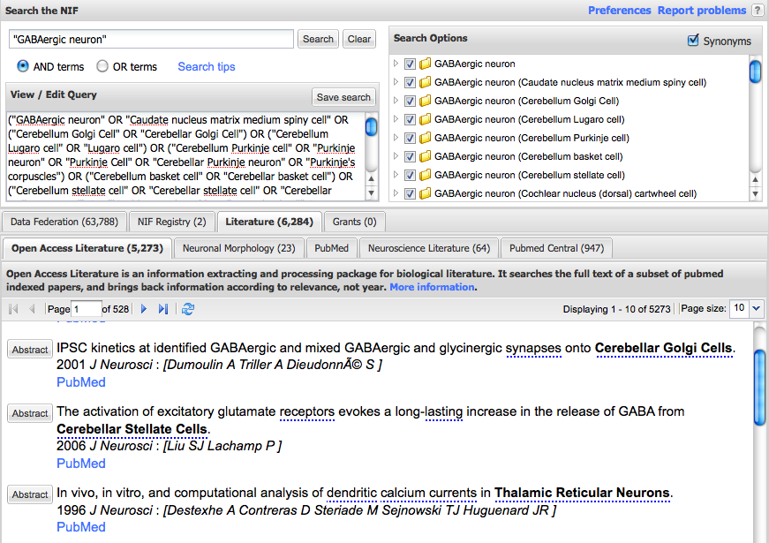
NIF Concept-Based Search
Incorporate basic neuroscience knowledge into search
Google: searches for string “GABAergic neuron)
NIF automatically searches for types of GABAergic neurons
Types of GABAergic neurons
Neuroscience Information Framework – http://neuinfo.org

Slide 13
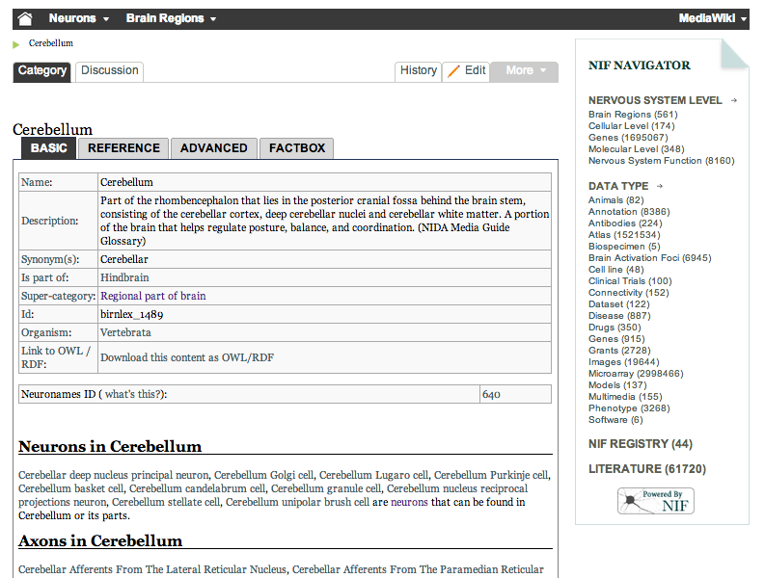
Working with and extending ontologies: Neurolex.org
Semantic MediWiki
Provide a simple interface for defining the concepts required
Light weight semantics
Good teaching tool for learning about semantic integration and the benefits of a consistent semantic framework
Community based:
Anyone can contribute their terms, concepts, things
Anyone can edit
Anyone can link
Accessible: searched by Google
Growing into a significant knowledge base for neuroscience
International Neuroinformatics Coordinating Facility
http://neurolex.org
Larson et al, Frontiers in Neuroinformatics, in press

Slide 14
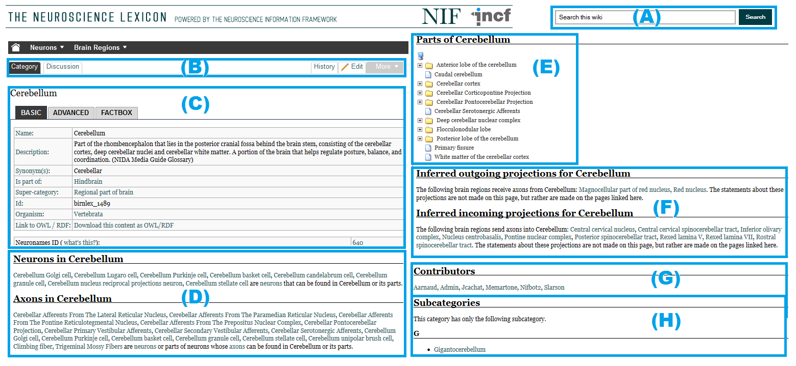
NeuroLex Content : Mixture of assertions and computed relations
{{#ask: [[Category:Neuron]] [[Located in.Is part of.Is part of.Is part of::Category:Cerebellum]] OR
[[Located in.Is part of.Is part of::Category:Cerebellum]]
OR [[Located in.Is part of::Category:Cerebellum]]
OR [[Located in::Category:Cerebellum]]
Stephen D. Larson et al.
Notes:
NeuroLex has a semantic backend to structure its overall knowledge, a page in NeuroLex can dynamically call relevant information from other pages. For example, NeuroLex has the ability to automatically assemble related knowledge about Cerebellum as shown in the boxes corresponding to (D), (E), and (F) in the figure. Note that the information contained in (D) and (F) are not entered as part of the ‘Cerebellum’ page itself, but are automatically assembled from the edits made to other pages, e.g., if a user enters a soma location for a neuron that is a part of cerebellum, the neuron automatically shows up on this page under the "Neurons in cerebellum" in section (D). Analogously, the "Axons in Cerebellum" in section (D) is also populated from the edits made in other pages. Finally, NeuroLex is meant to house all concepts of relevance to neuroscience, regardless of whether or not they are particularly noteworthy.

Slide 15
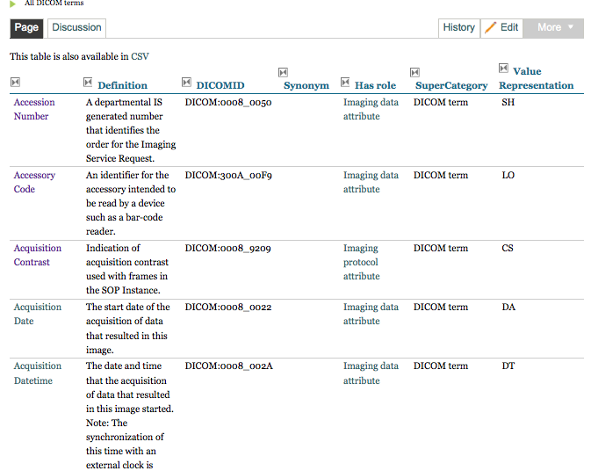
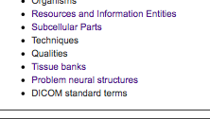
Contributions to Neurolex
> 1000 Dicom Terms
Karl Helmer
Data Sharing Task Force
Tasks and Cognitive Concepts from Cognitive Atlas
Russ Poldrack
>280 Neurons
Gordon Shepherd and 30 world wide experts
~500 fly neurons from Fly Anatomy Ontology
David Osumi-Sutherland
>1200 Brain parcellations
Neurolex is growing into a significant knowledge base: Available through spreadsheet downloads, through NIF Web Services, SPARQL endpoint

Slide 16
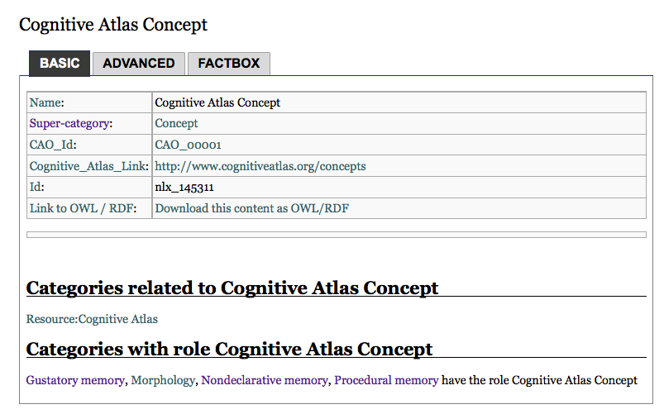
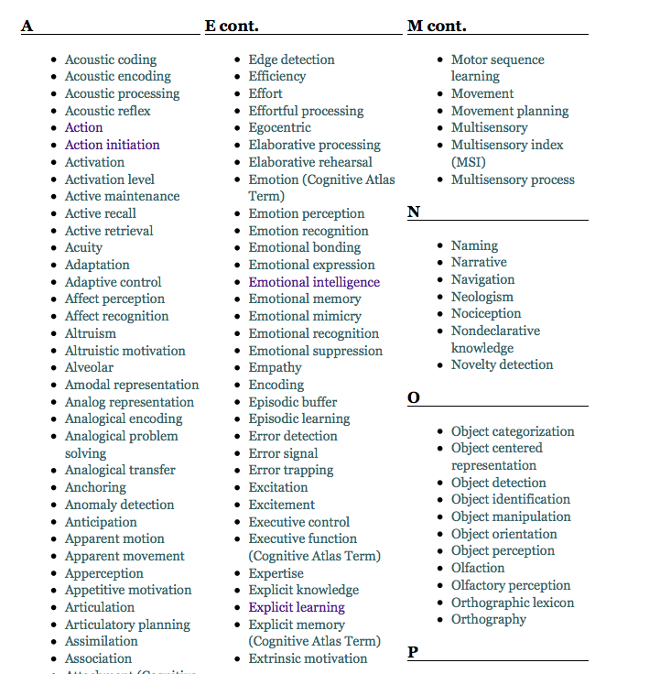
Concept? Thing? Doesn’t matter here
Community contributes as they can; content gets reconciled over time

Slide 17
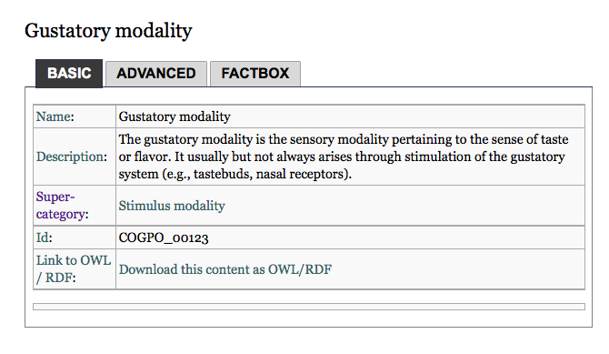
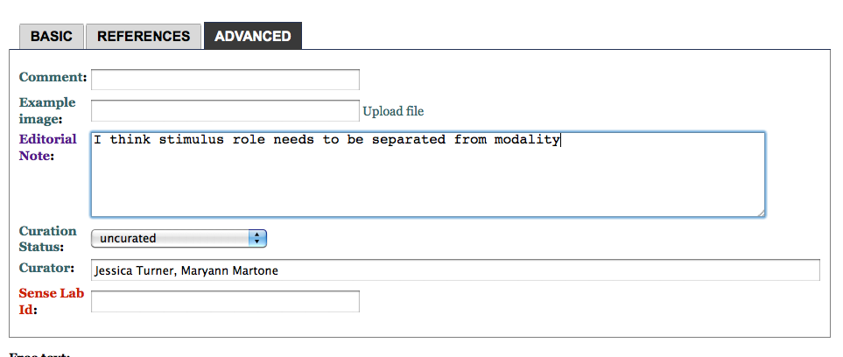
Nevertheless...
Neurolex does not allow duplicates
We do not allow multiple inheritance
Use “role” as a shortcut
We do try to re-factor contributions so as to avoid collisions across our domains
Pages may be watched
Content is curated using Wiki tools and forms
But...once they are in the wiki, they will move about and be added to as necessary

Slide 18
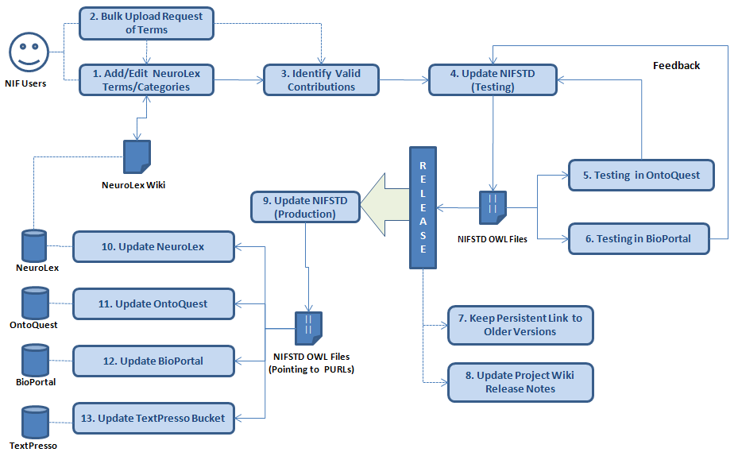
NifStd/Neurolex Workflow
Neuron X ‘has soma location’ in Brain Region Y in NeuroLex == >
‘Neuron X’ has_part some (‘Soma’ and (part_of some ‘Brain region Y’)) in NIFSTD
Neuroscience Information Framework – http://neuinfo.org
Notes:
We envision NeuroLex as the main entry point for the broader community to access, annotate, edit and enhance the core NIFSTD content. The peer-reviewed contributions in the media wiki are later implanted in formal OWL modules.
While the properties in NeuroLex are meant for easier interpretation, the restrictions in NIFSTD are usually based on rigorous OBO-RO standard relations. For example, the property ‘soma located in’ is translated as ‘Neuron X’ has_part some (‘Soma’ and (part_of some ‘Brain region Y’)) in NIFSTD.
The Neurolex Wiki is a curated site; that is, members of the NIF and affiliated projects regularly review the content and may modify it as necessary. The Wiki was set up for the purpose of providing the community an opportunity to contribute categories and definitions to enhance description and access to neuroscience-relevant data.
The concepts contributed on the Wiki are used to help build the NIF ontologies.
When new categories are created or new relationships added, the NIF curators determine whether the category needs to be added to our ontologies. This determination is made based on whether we have a current ontology covering the domain, whether the category is unique, that is, it does not already exist under another label, and whether it is relevant to the mission of the NIF. If these conditions are met, the category is added to the NIFSTD ontology.
Categories that are added to the NIFSTD receive a unique identifier, usually of the form nlx_####. If the category already exists in a community ontology, the identifier assigned in the original ontology is reused. If a category is determined to already exist, the label used is usually added as a synonym to the existing category. In this case, the original category page is usually deleted. Any changes to a page can be viewed by clicking on the "history" tab.

Slide 19
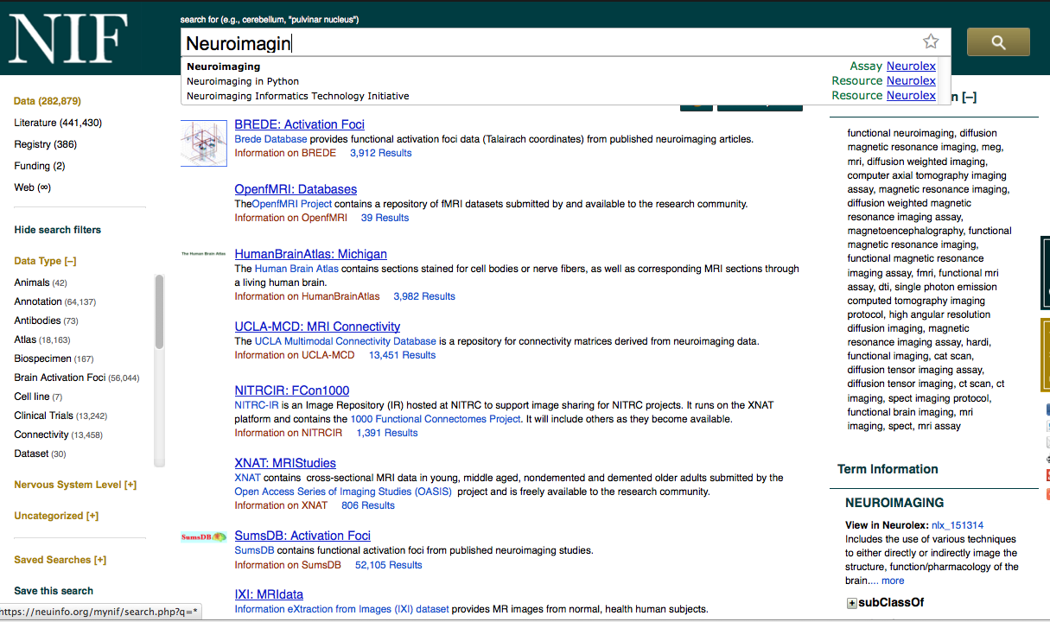
NIFSTD Defined Classes
Neurons classified by
Circuit role: principal neuron vs interneuron
Molecular constituent: Parvalbumin-neurons, calbindin-neurons
Brain region: Cerebellar neuron
Morphology: Spiny neuron
Molecule Roles: Drug of abuse, anterograde tracer, retrograde tracer
Brain parts: Circumventricular organ
Organisms: Non-human primate, non-human vertebrate
Qualities: Expression level, age categories
Techniques: Neuroimaging
Arbitrary but defensible
Equivalence classes; restrictions
Notes:
NIFSTD has includes a set of defined classes to infer useful classification of neuron types and molecules.

Slide 20
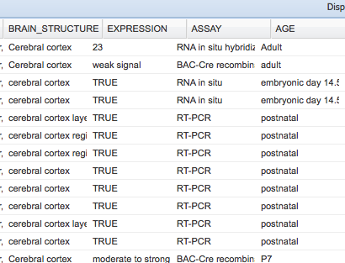
Is GRM1 in cerebral cortex?
Allen Brain Atlas
Gensat
MGD
Little consistency in the representation of expression values or age categories

Slide 21
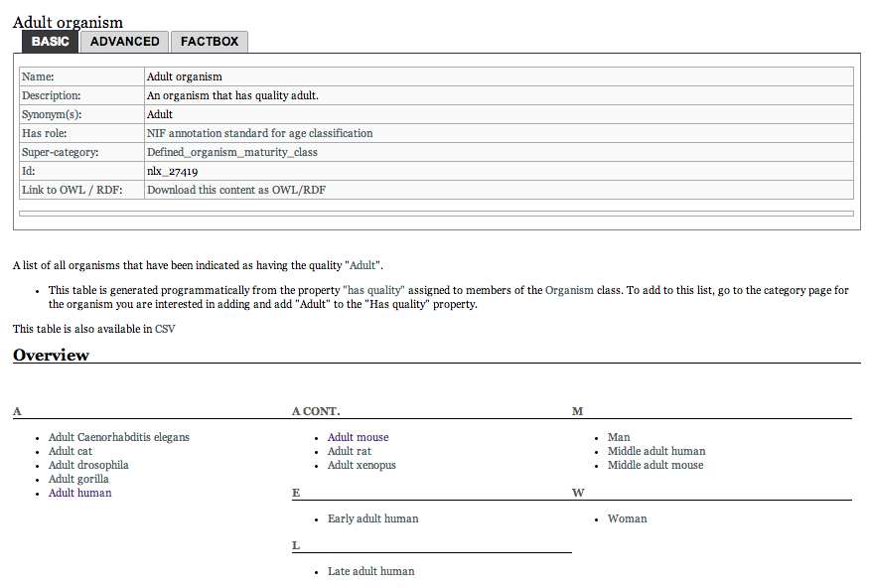
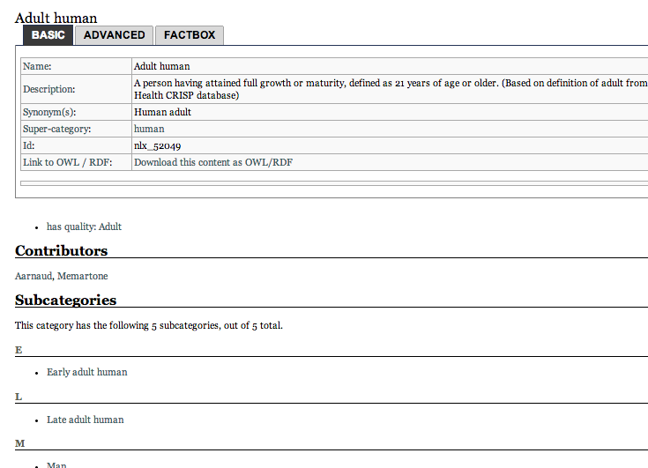
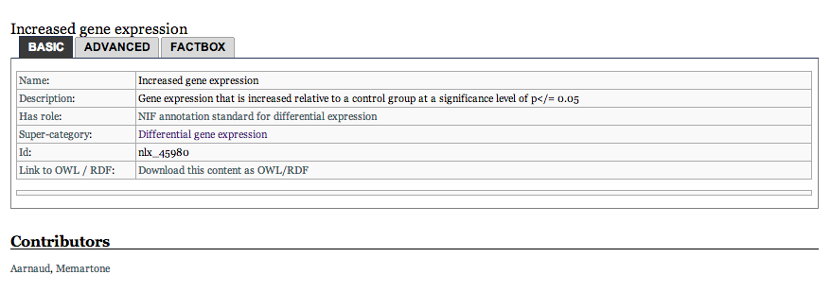
NIF Annotation Standards
Maturity
Expression level

Slide 22
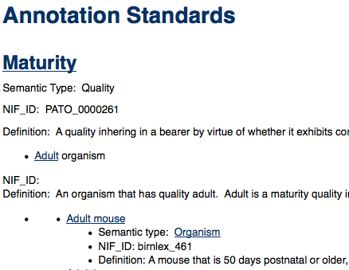
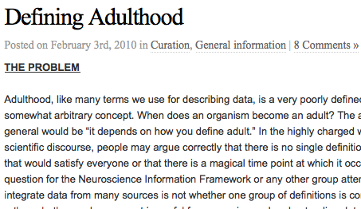
How old is an adult squirrel?
Definitions can be quantitative
Arbitrary but defensible
Qualitative categories for quantitative attributes
Best practice to provide ages of subjects, but for query, need to translate into qualitative concepts
Jonathan Cachat, Anita Bandrowski

Slide 23
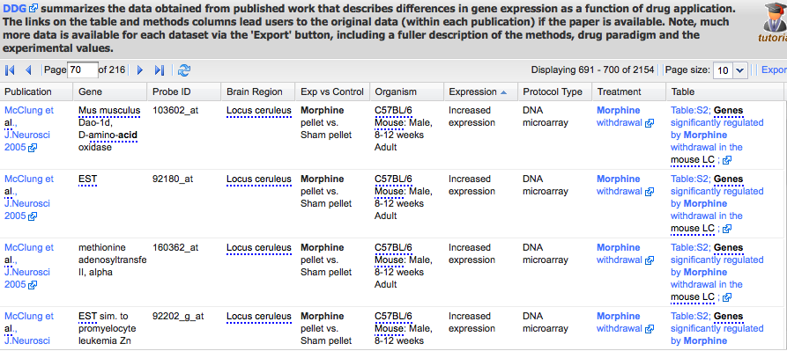
NIF “translates” common concepts through ontology and annotation standards
What genes are upregulated by drugs of abuse in the adult mouse? (show me the data!)
Morphine
Increased expression
Adult Mouse

Slide 24
Analysis of NIF Queries 1000 queries from Sept 2013
10 queries contained a reference to quantity
Adolescent depression; depression in elderly, hippocampal volume, adolescent impulsivity, cerebral peduncle low density, adult, 7 tesla, older adults, “earlier vs later levodopa treatment Parkinson’s”

Slide 25
Planned: Quantitative equivalence classes
Currently, NIF expression and maturity are only annotation classes
Planning on turning them into “quantitative equivalence classes”
i.e., if human > 21 yrs of age = adult human
NIF now handles numbers as data types
Several organism stage ontologies are now available:
http://code.google.com/p/developmental-stage-ontologies/wiki/MmusDv
Stages are modeled as occurrents using Allen Interval Algebra to connect them
https://code.google.com/p/developmental-stage-ontologies/wiki/Timings
Working with Chris Mungall, Melissa Haendel to map NIF age classes to these ontologies

Slide 26
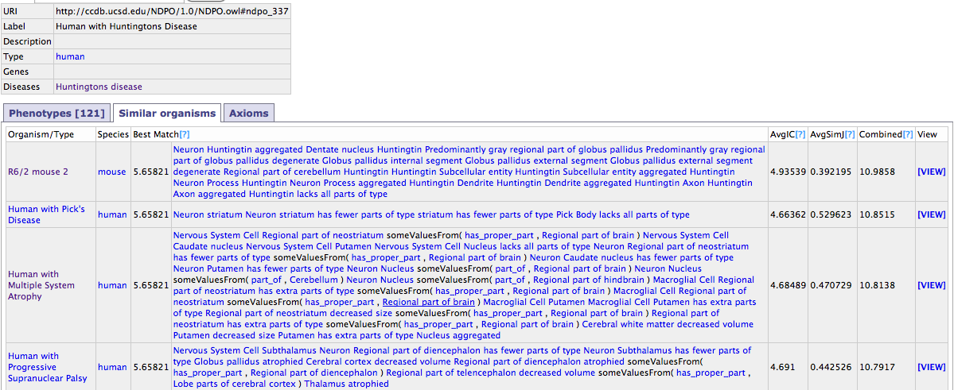
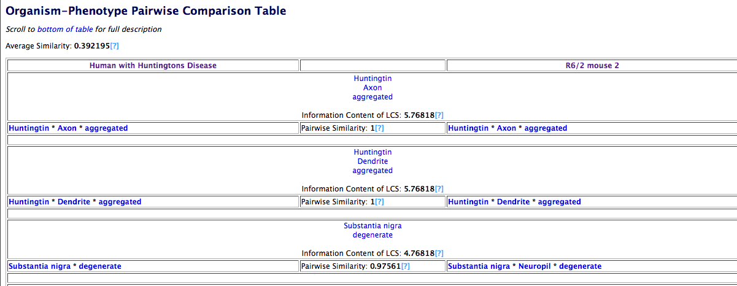
PhenoSim: What organism is most similar to a human with Huntington’s disease?
Maynard et al., Frontiers in Neuroinformatics, 2013
Part of basal ganglia decreased in magnitude
Putamen atrophied
Globus pallidus neuropil degenerate
Neuron in striatum decreased in magnitude
Fewer neostriatum medium spiny neurons in putamen
Neurons in striatum degenerate
Nervous system cell change in number in striatum
Increased number of astrocytes in caudate nucleus
Neurons in striatum degenerate
*B6CBA-TgN (HDexon1)62) that express exon1 of the human mutant HD gene- Li et al., J Neurosci, 21(21):8473-8481
Notes:
In validating our results, we see three types of matches.
The first are direct matches
NOTE: should make diagram in the style of previous slides (not screenshot)

Slide 27
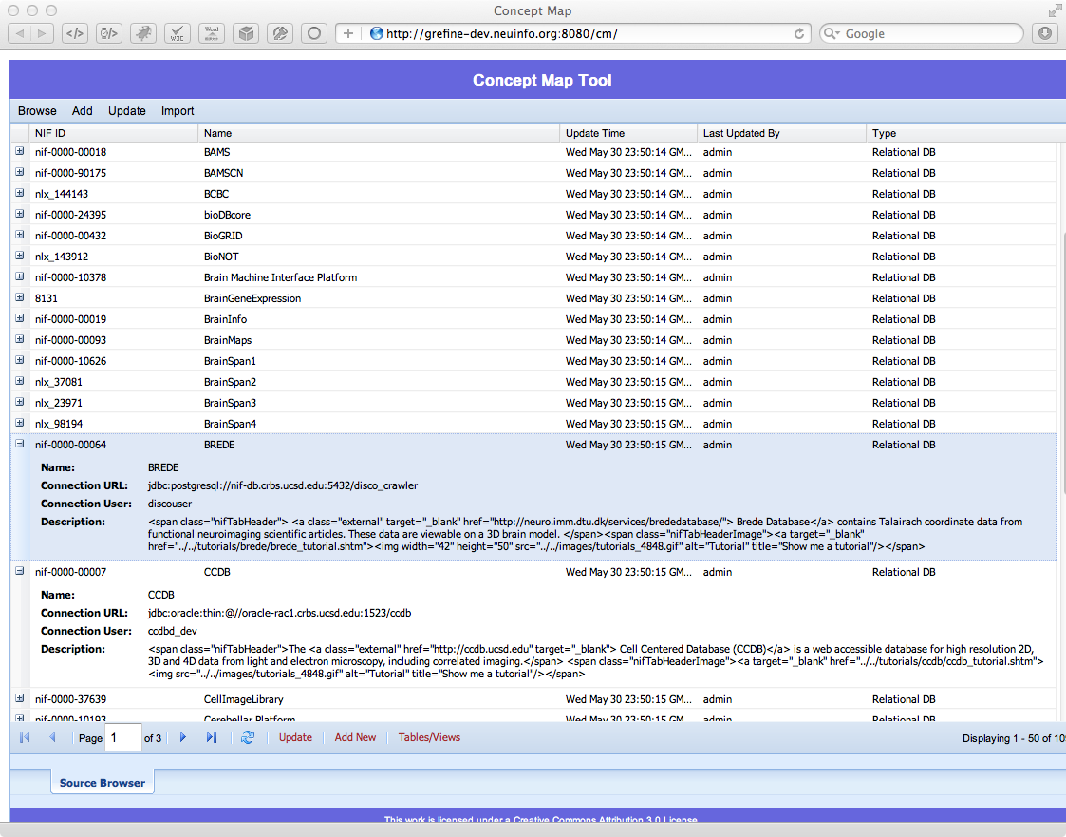
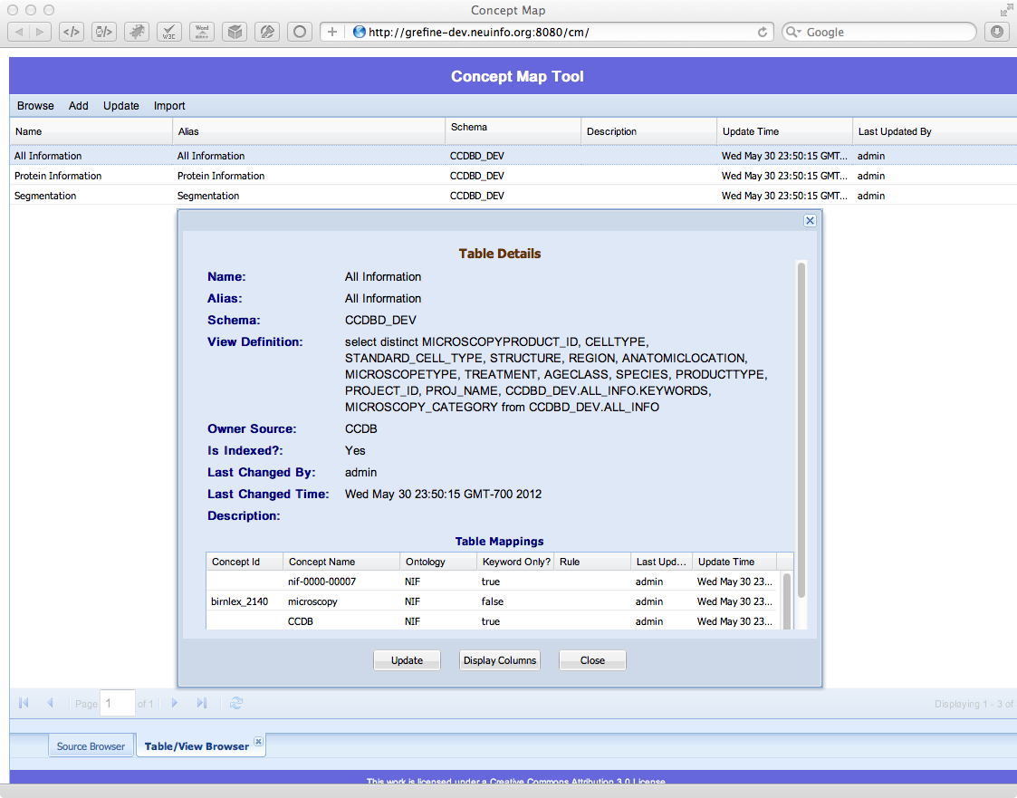
NIF Concept Mapper
Aligns sources to the NIF semantic framework

Slide 28
NIF Column maps
Anatomy
Antibody
Cell
Coordinate
Disease
Environment
Full Text
Function
Gene
Gene-target Reagent
Genomic Locus
Genomic locus variant
Genotype
Identifier
Interaction
Interaction Type
Molecular Domain
Molecule
Organism
Pathway
Phenotype
Protocol
Publication
Quality
Resource
Sequence
Specimen
Stage
Strain
Sub-cellular Anatomy
Next: Inter-column relationships

Slide 29
Data sources come in different flavors
NIF favors a hybrid, tiered, federated system
Domain knowledge
Ontologies
Claims, models and observations
Virtuoso RDF triples
Model repositories
Data
Data federation
Spatial data
Workflows
Narrative
Full text access
Organism
Gene
Neuron
Brain part
Disease
Technique
People
Caudate projects to Snpc
Grm1 is upregulated in chronic cocaine
Betz cells degenerate in ALS
Observations, experiments, studies

Slide 30
Phenotype Needs: Quantity to Quality
Representation of neuropsychological and neurological tests and assessments
→ Relate to mental and cognitive phenotypes
→ Relate to disease phenotypes
Event qualities: before and after
Size qualities: hypertrophied

Slide 31
Many thanks to...
Amarnath Gupta
Xufei Qian
Burak Ozybul
Anita Bandrowski
Luis Marenco
Jeff Grethe
Fahim Imam
Trish Whetzel (NIF’s new ontologist)
Bill Bug**
Chris Mungall
Melissa Haendel
Suzie Lewis
Stephen Larson
Jing Chen
Yueling L
Zaid Aziz
Akash Sonkar
Andrea Arnaud-Stagg

Slide 32
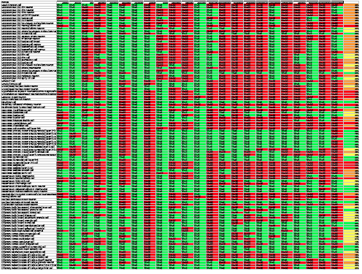
Neurolex is becoming a significant knowledge base
Cochlear nucleus
Neocortex
Neostriatum
Olfactory bulb
Properties in Neurolex
All neurons with cell bodies in the same brain region are grouped together

Slide 33
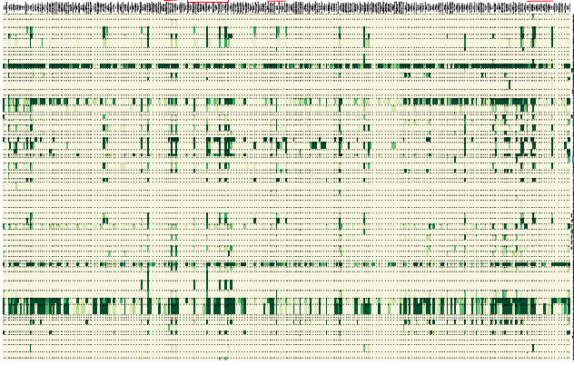
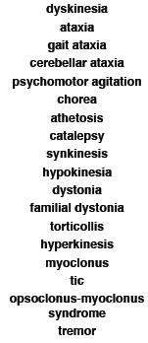
Semantic framework to reveal landscape and expose knowledge gaps
Diseases of nervous system
Neurodegenerative
Seizure disorders
NIF data federated sources
Neoplastic disease of nervous system
NIH Reporter
Kepler workflow engine

Slide 34
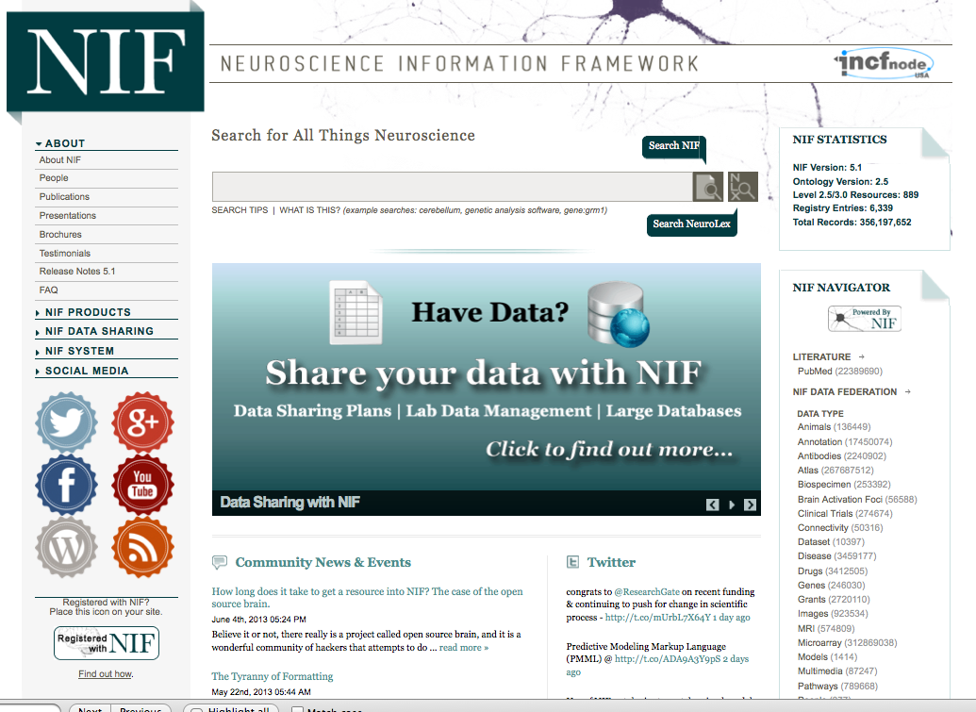
The Neuroscience Information Framework
NIF has developed a production technology platform for researchers to:
Discover
Share
Analyze
Integrate
neuroscience-relevant information
Since 2008, NIF has assembled the largest searchable catalog of neuroscience data and resources on the web
3 main indices: NIF Registry-Data Federation-NIF Literature
“This unique data depository serves as a model for other Web sites to provide research data. “ - Choice Reviews Online
NIF is poised to capitalize on the new tools and emphasis on big data and open science

