Slide 1
Experience with the development and operation of the Neuroscience Information Framework (NIF) portal
Maryann E. Martone, Ph. D.
University of California, San Diego

Slide 2
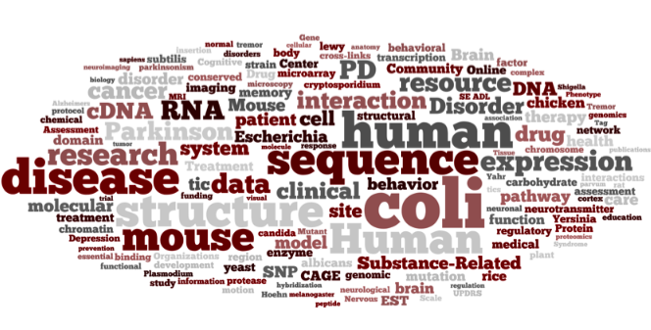
NIF is an initiative of the NIH Blueprint consortium of institutes
What types of resources (data, tools, materials, services) are available to the neuroscience community?
How many are there?
What domains do they cover? What domains do they not cover?
Where are they?
Web sites
Databases
Literature
Supplementary material
Who uses them?
Who creates them?
How can we find them?
How can we make them better in the future?
PDF files
Desk drawers
http://neuinfo.org

Slide 3
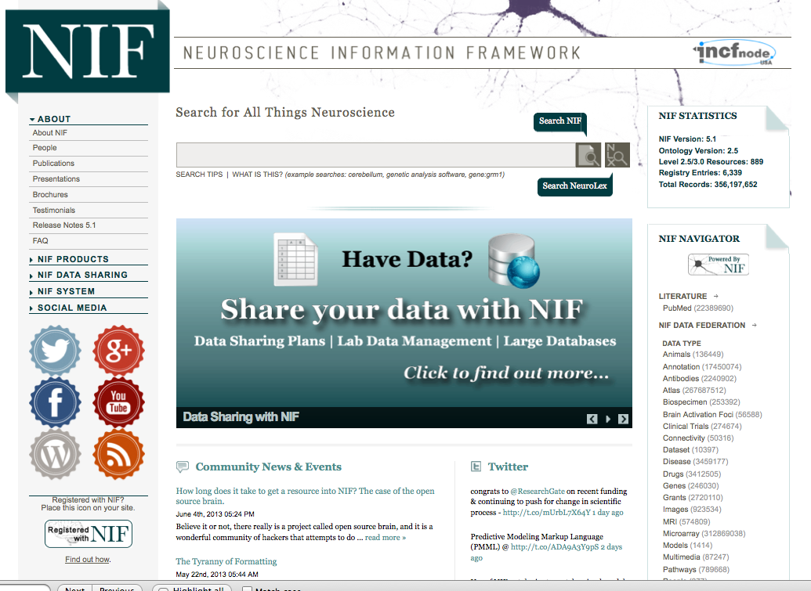
The Neuroscience Information Framework
NIF has developed a production technology platform for researchers to:
Discover
Share
Analyze
Integrate
neuroscience-relevant information
Since 2008, NIF has assembled the largest searchable catalog of neuroscience data and resources on the web
Cost-effective and innovative strategy for managing data assets
“This unique data depository serves as a model for other Web sites to provide research data. “ - Choice Reviews Online
NIF is poised to capitalize on the new tools and emphasis on big data and open science

Slide 4
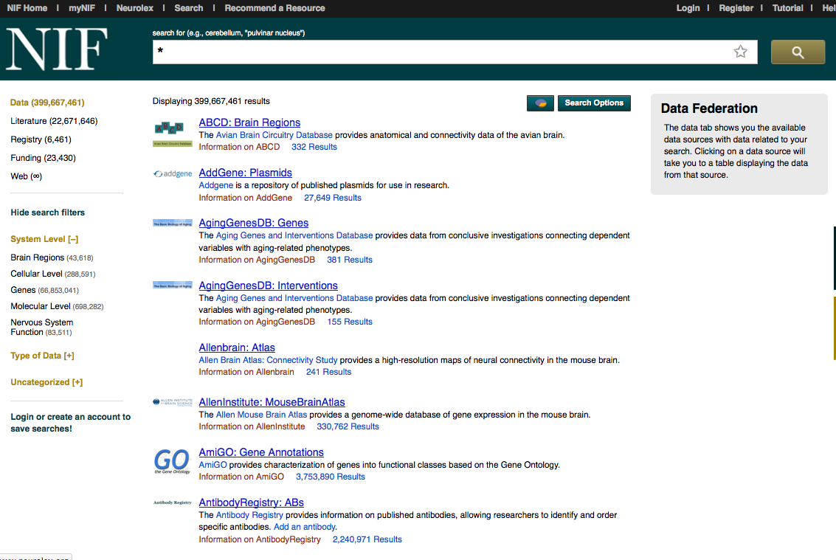
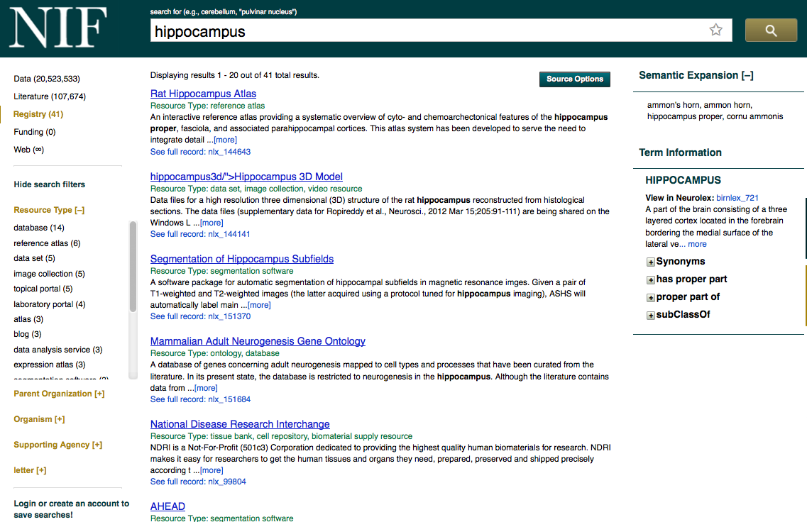
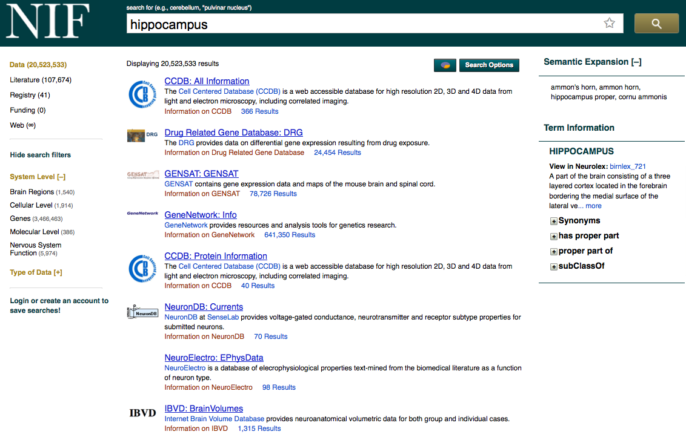
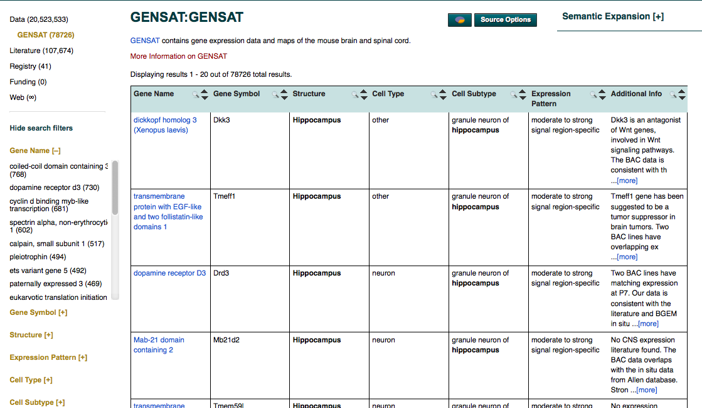
NIF searches across 3 main indices: Registry, Federation and Literature
Data Federation:
200 databases/400M records
Registry: 6300 resources
(2500 databases)
Literature: 22 million articles

Slide 5
NIF must work with ecosystem as it is today
NIF was one of the first projects to attempt data integration in the neurosciences on a large scale
NIF is supported by a contract that specified the number of resources to be added per year
Designed to be populated rapidly; set up process for progressive refinement
No budget was allocated to retrofit existing resources; had to work with them in their current state
We designed a system that required little to no cooperation or work from providers
Supports many formats: relational, XML, RDF
Notes:
Doesn’t do it well; doesn’t organize the results in a domain specific way; doesn’t search across it
For use as content goal Dynamic inventory for deep coverage of neuroscience data: Genes -> Systems

Slide 6
NIF Semantic Framework: NIFSTD ontology
NIFSTD
Organism
Anatomical Structure
Cell
Dysfunction
Quality
Molecule
Subcellular structure
NS Function
Investigation
Macromolecule
Gene
Techniques
Resource
Instrument
Molecule Descriptors
Reagent
Protocols
NIF covers multiple structural scales and domains of relevance to neuroscience
Aggregate of community ontologies with some extensions for neuroscience, e.g., Gene Ontology, Chebi, Protein Ontology

Slide 7
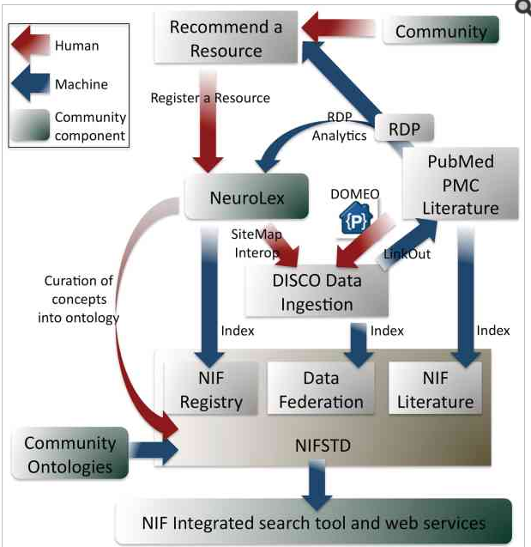
How do resources get added to the NIF?
NIF curators
Nomination by the community
Semi-automated text mining pipelines
NIF Registry
Requires no special skills
Site map available for local hosting
NIF Data Federation
DISCO interop
Requires some programming skill
Open Source Brain < 2 hr
Two tiered system: low barrier to entry + progressive refinement

Slide 8
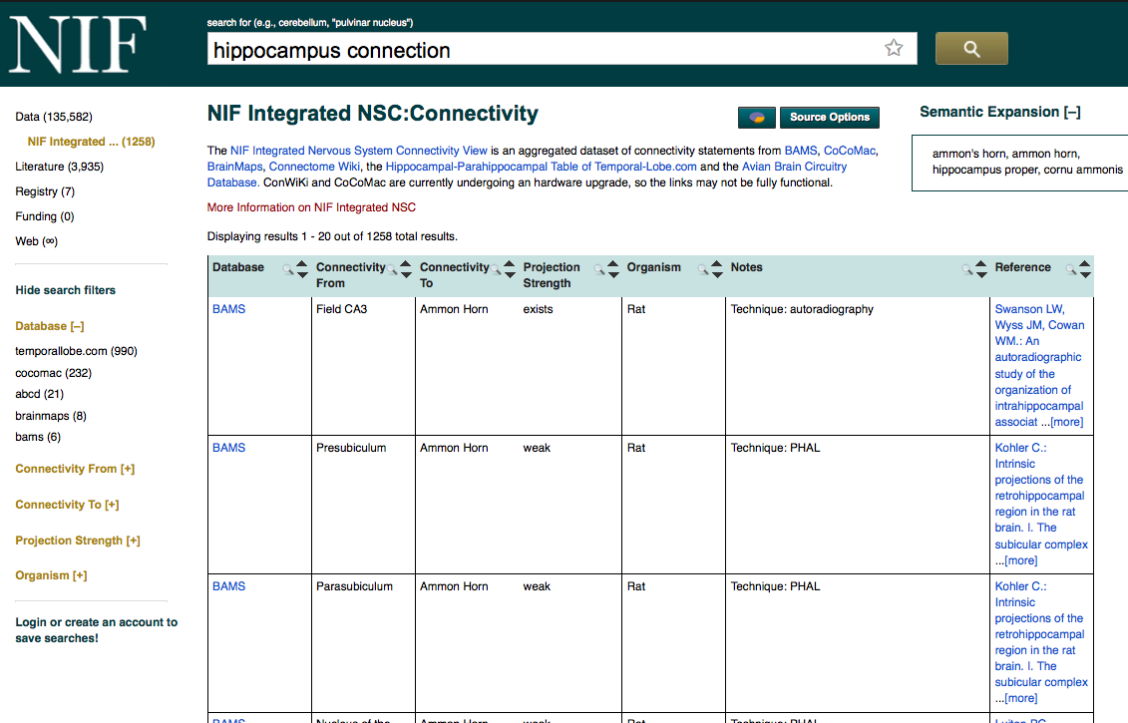
Inside the federation: What are the connections of the hippocampus?
Hippocampus OR “Cornu Ammonis” OR “Ammon’s horn”
Query expansion: Synonyms and related concepts
Boolean queries
Data sources categorized by “data type” and level of nervous system
Tutorials for using full resource when getting there from NIF
Common views across multiple sources
Link back to record in original source

Slide 9
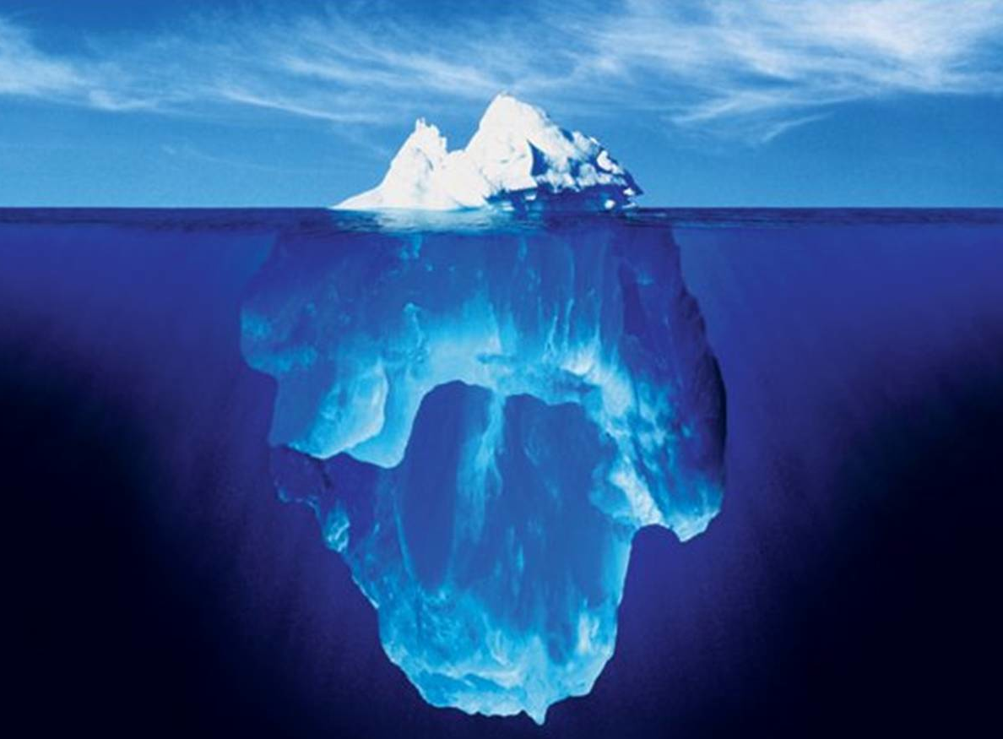
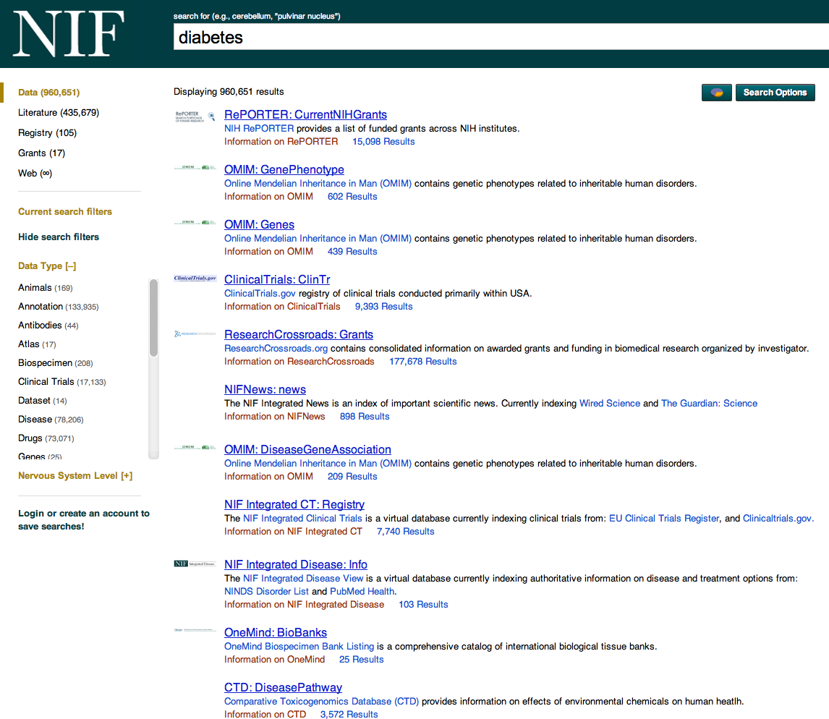
Progressive Refinement of Data
Web of Data
Enhanced semantics
Standardized representation
Linked Open Data - RDF
Accessibility
Data specified via simple semantics
Data in a usable form
Semantically-enabled search
Discoverability
Data resources simply described
Automated data harvesting technologies
Common resource registry
Processing of data from different sources can be tailored to requirements…

Slide 10
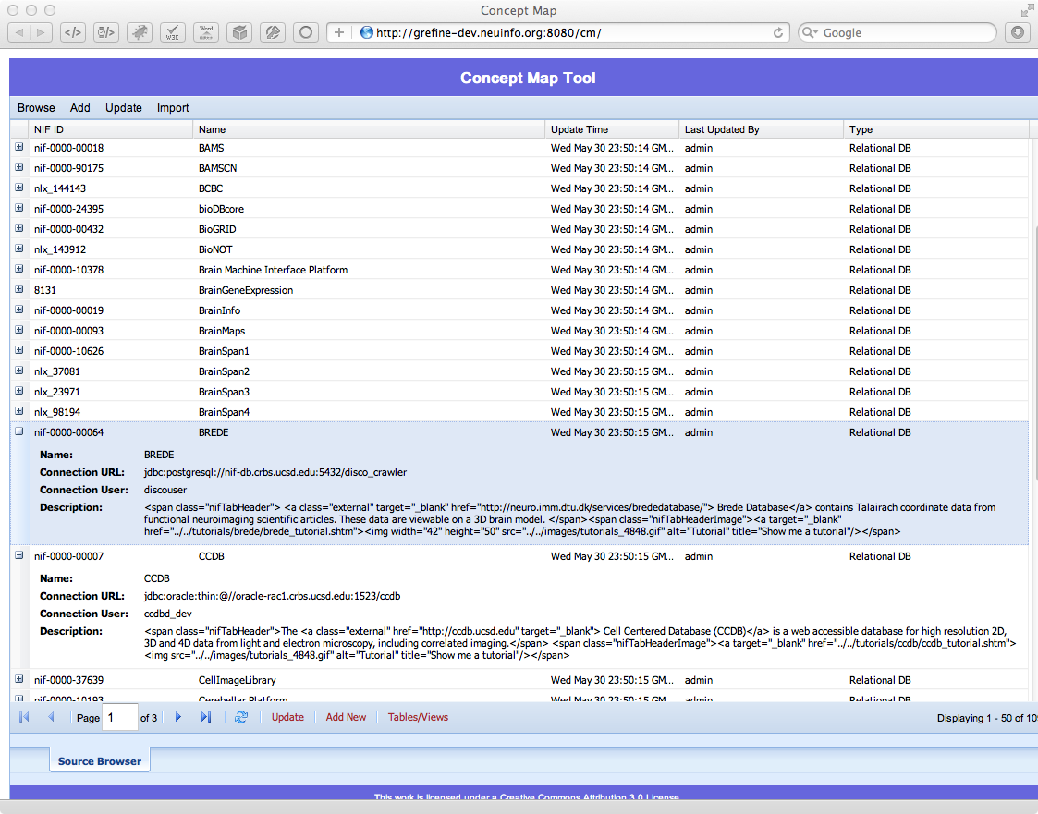
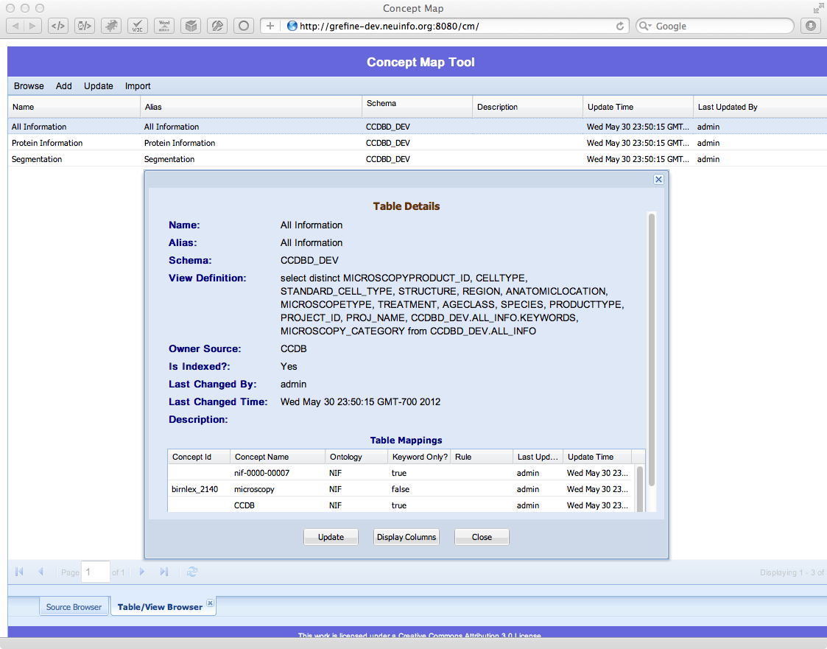
390 million records! NIF Concept Mapper
Aligns sources to the NIF semantic framework

Slide 11
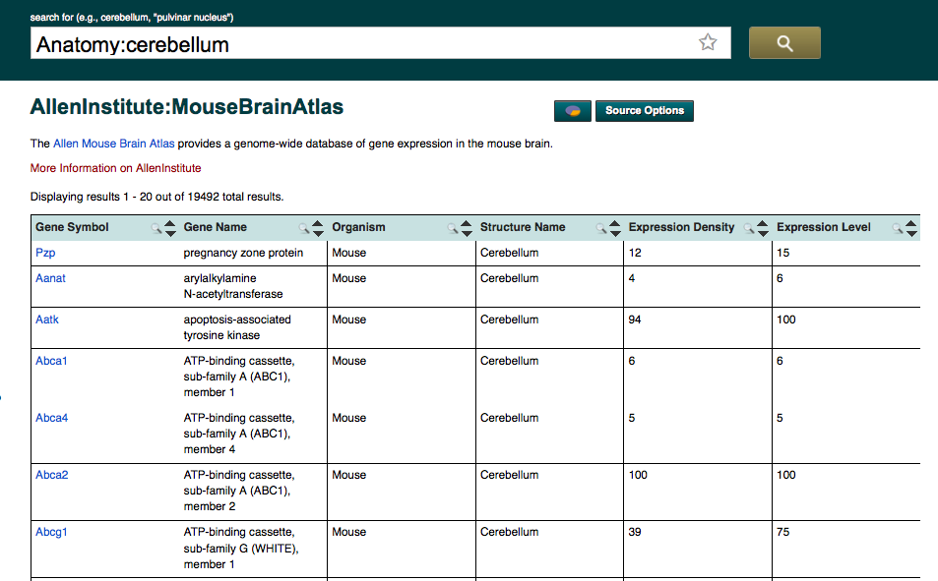
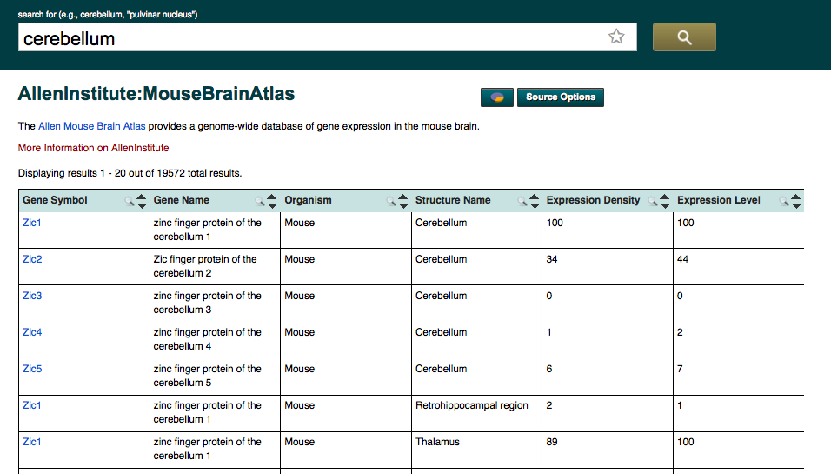
Column level mapping: Reducing false positives
Gene
Gene
Organism
Anatomy
Notes:
Change to hippocampus?

Slide 12
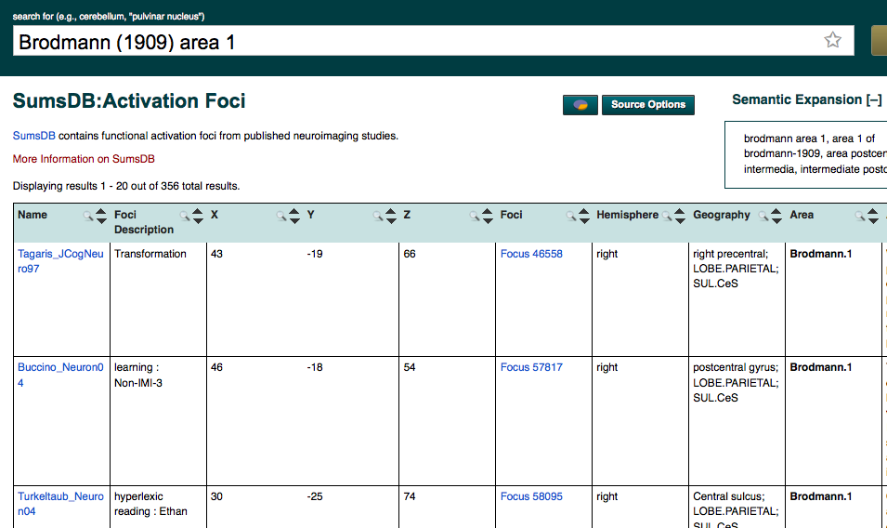
Entity mapping
birnlex_1732
Brodmann.1
Explicit mapping of database content helps disambiguate non-unique and custom terminology: Google Refine tools and services

Slide 13
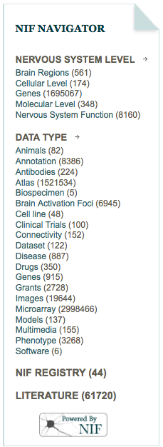
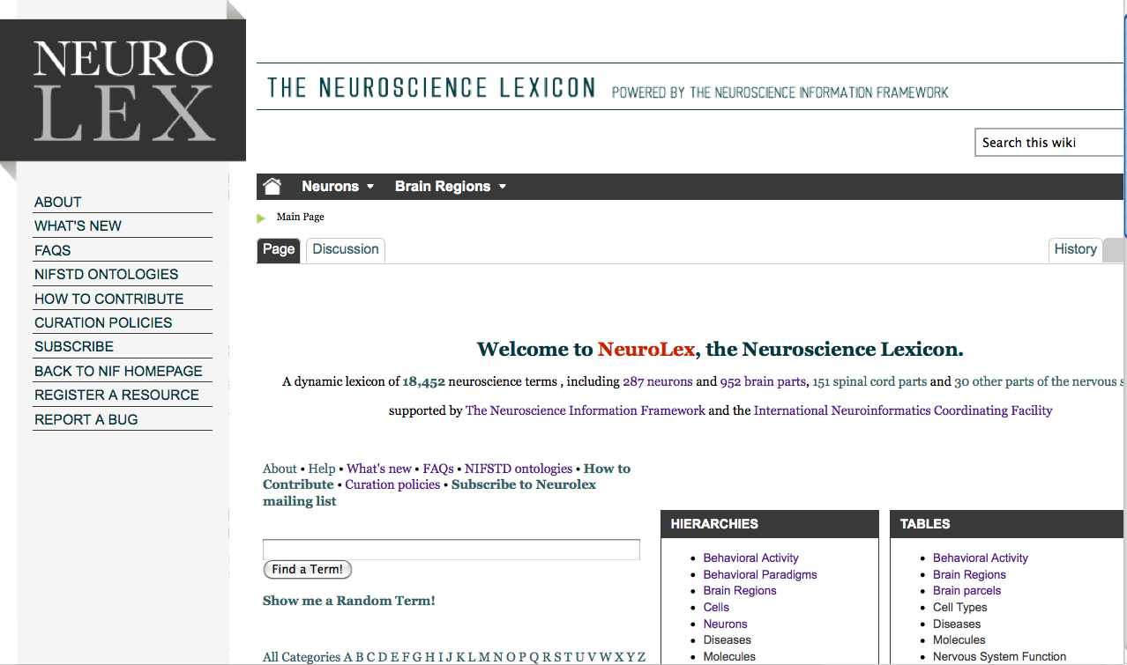
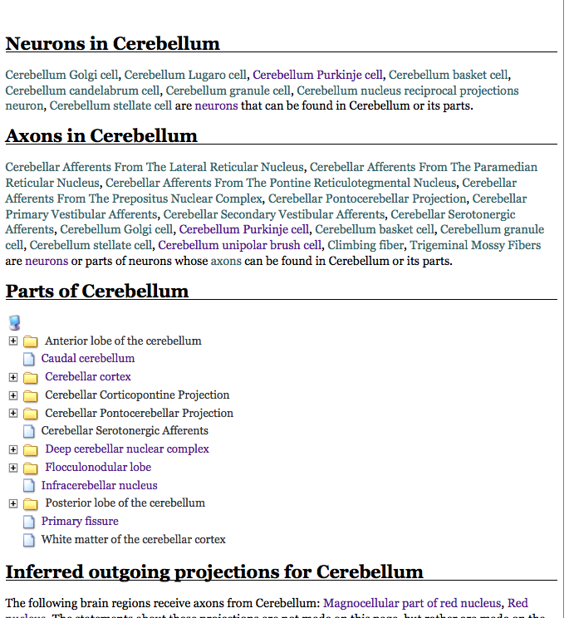
Working with and extending ontologies: Neurolex.org
Semantic MediWiki
Provide a simple interface for defining the concepts required
Light weight semantics
Good teaching tool for learning about semantic integration and the benefits of a consistent semantic framework
Community based:
Anyone can contribute their terms, concepts, things
Anyone can edit
Anyone can link
Accessible: searched by Google
Growing into a significant knowledge base for neuroscience
International Neuroinformatics Coordinating Facility
Demo D03
http://neurolex.org
Larson et al, Frontiers in Neuroinformatics, in press

Slide 14
Who uses NIF?

Slide 15
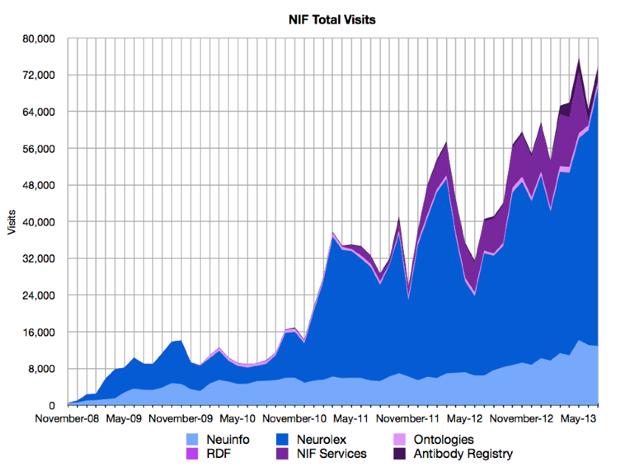
Usage of NIF

Slide 16
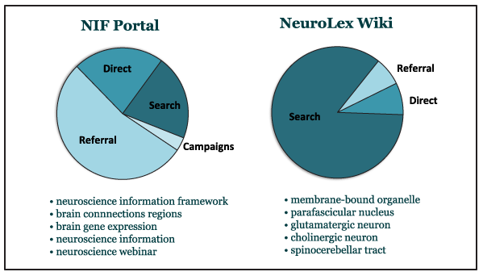
Building knowledge in the web
Because they are static URL’s, Wikis are searchable by Google

Slide 17
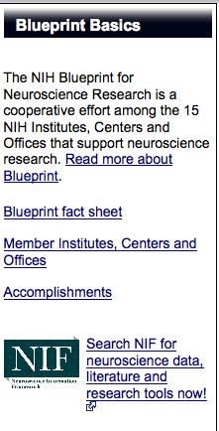
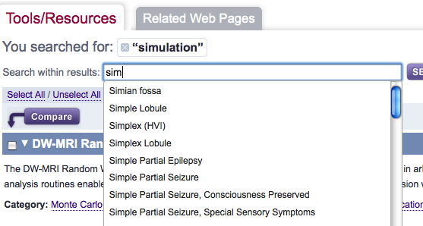
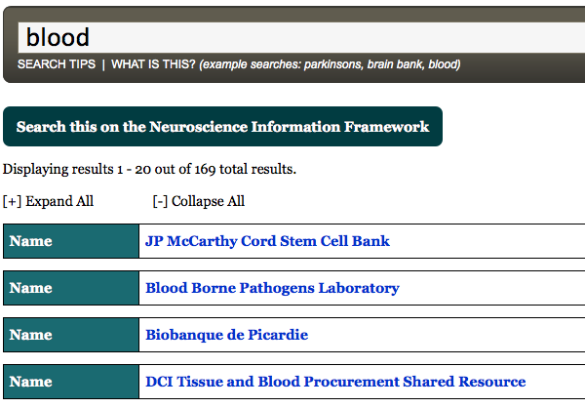
Data Services
Vocabulary
NITRC (autocomplete)
Neuroscience.com (annotate)
3. INCF Atlasing tools
Data Summary (NIF Navigator)
NIDA, Blueprint
NeuroLex
Individual Data Sources
DOMEO
OneMind
Eagle i
DISCO Services (LinkOut)
PubMed
Current
Planned
Anita Bandrowski, Jeff Grethe
Notes:
Change the white text in boxes to green; whole brain catalog implements autocomplete (INCF funded project); add kepler to this slide,

Slide 18
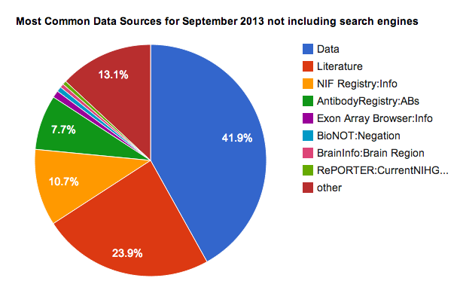
People use NIF to...
Top NIF sources
Find resources
“Where can I find a translation of Talaraich to MNI coorindates- NIF Forum
“Where are all the biospecimen repositories?”-One Mind for Research
“What biospecimen banks are available with tissues from opiate addicts?”-NIH
Find answers
What is the amount of data published on males vs females- NIH
“Where is my gene expressed”- Researcher
“What projects to the ventral lateral geniculate nucleus”-researcher
Track resource utilization
What projects are using my antibody/mouse/database?
Serve as a springboard
NIF ontologies, tools and data resources are used by many groups (20,000 hits/month on NIF services)
NIF technologies and expertise jumpstart related efforts
Data
Registry
Literature
Top search terms
Notes:
Provide details on one case not all
Unsolicited!!!

Slide 19
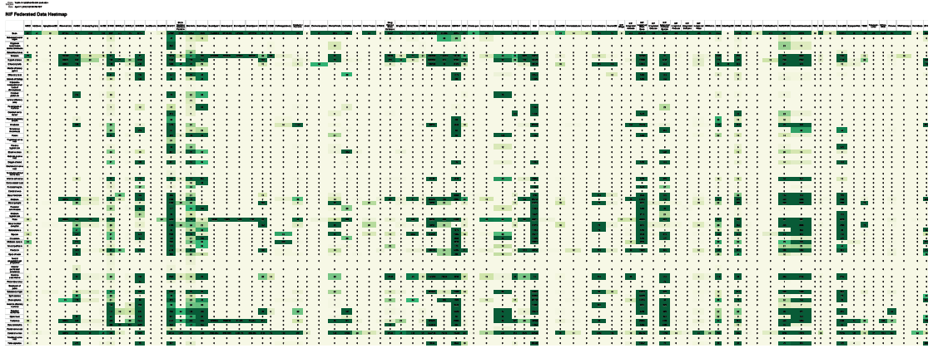
NIF Analytics: The Neuroscience Landscape
Where are the data?
Striatum
Hypothalamus
Olfactory bulb
Brain
Data source
Funding
Brain region
Cerebral cortex
Exposing knowledge gaps and biases

Slide 20
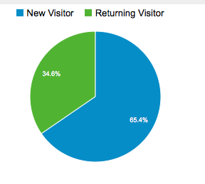
Metrics of success
Return visits:
>1000 per month come more than once
196 sites have NIF links on their pages
> 100 research libraries list us in their library guides
~350 colleges and universities visit per month
3 professional societies
> 21 papers that use NIF
2 that mention uses of data
5 that use NIF ontology

Slide 21
NIF Resource Services: Linking and tracking resource utilization

Slide 22
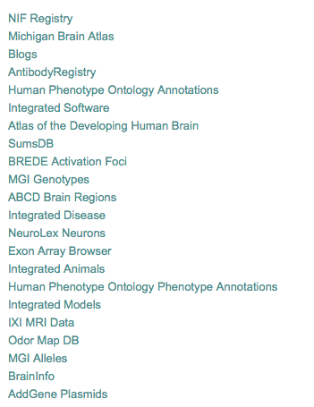
Tracking resource growth and utilization
Promoting resources in our federation
Webinar series
NIF Digest
Providing resource growth statistics
Making sure resources are “alive”
Top 25 databases for August 2013
NIF provides support for resource providers; they are our customers too

Slide 23
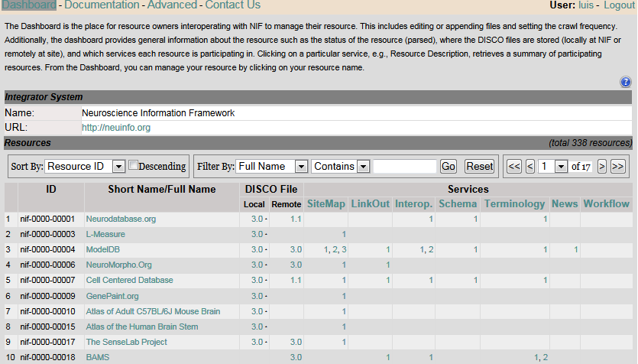
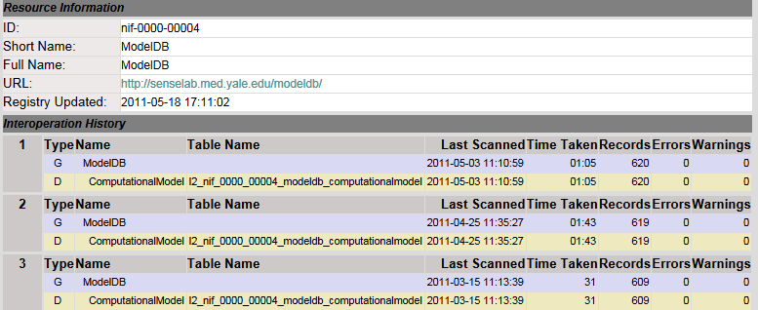
DISCO Dashboard
Management of registry resources through a single administrative dashboard
Associated discovery pipeline
Tools to manage data updates
Change tracking
Globally unique identifier creation
Luis Marenco, Rixin Wang, Perrry Miller, Gordon Shepherd
Yale University
Notes:
Lists all NIF resources registered at levels 2+ in the DISCO server.
Shows their DISCO services, and location of DISCO files
Controls to filter, sort and page all resources

Slide 24
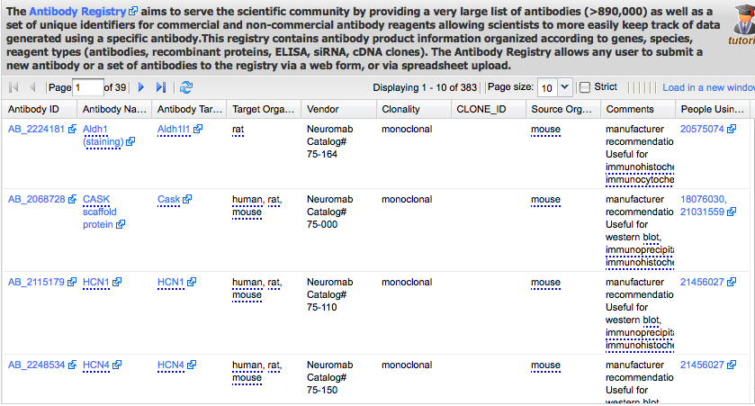
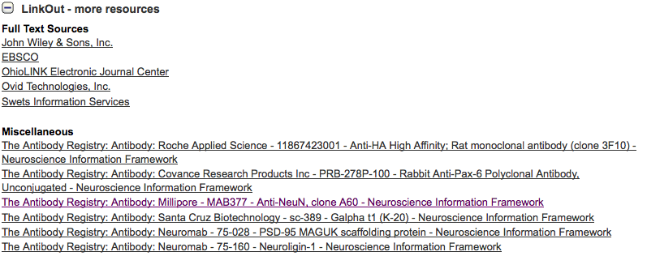
Cross-index and resource integration
NIF Data Federation
Pub Med Link Out via NIF Link Out Broker
Literature annotation with unique identifiers via DOMEO

Slide 25
Challenges and opportunities

Slide 26
User Requests and Challenges
Make it easier to find resources:
Spell checking
More expressive search, e.g., questions
Make it easier to track usage
Resource identification project-NIF Registry identifiers into published literature
Personalized services
Send updates/new sources that are relevant
“other people who searched for X looked at Y”
Ranking of data federation results
Keeping contents current
Measuring success:
Are we reaching our core audience; how can we tell?
NIF recently redesigned the portal to decouple the front end and the back end to make NIF more flexible

Slide 27
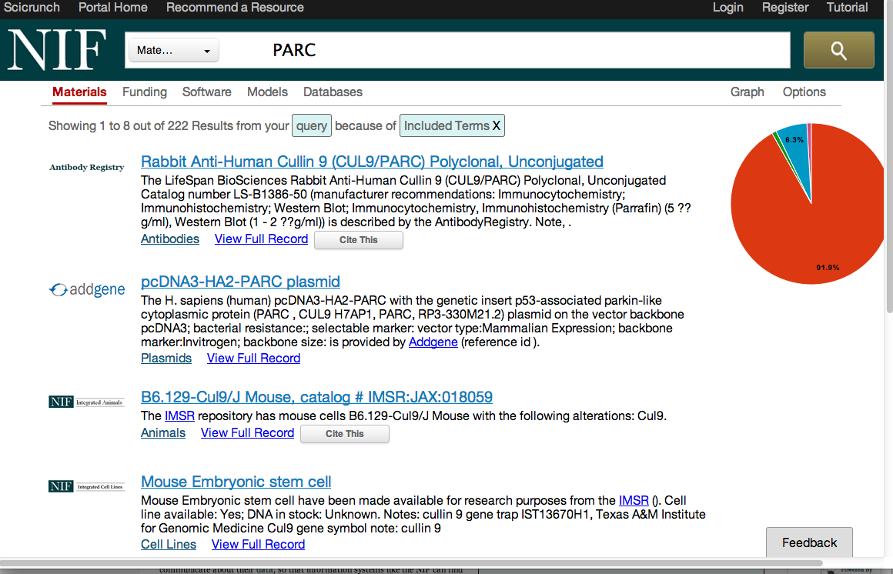
Resource View
http://dev.scicrunch.com/nif/
Combines Registry and selected databases
Snippets constructed from data record

Slide 28
Keeping the Registry Current
Last updated
Resources added
NIF employs an automated link checker
Last analysis: 478/6100 invalid URL’s (~8%)
199 can’t locate at another university or URL → out of service (~3%)
Bigger issue: 30-50% of resources are no longer updated or maintained
NIF has 5 years of data tracking digital resources

Slide 29
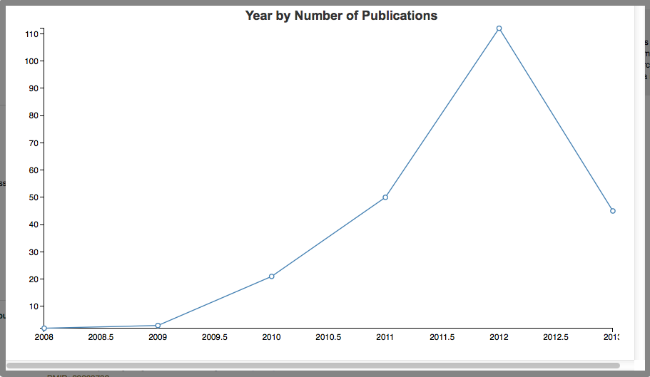
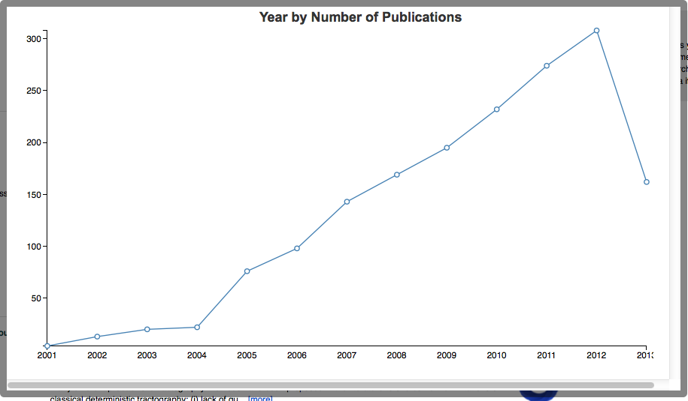
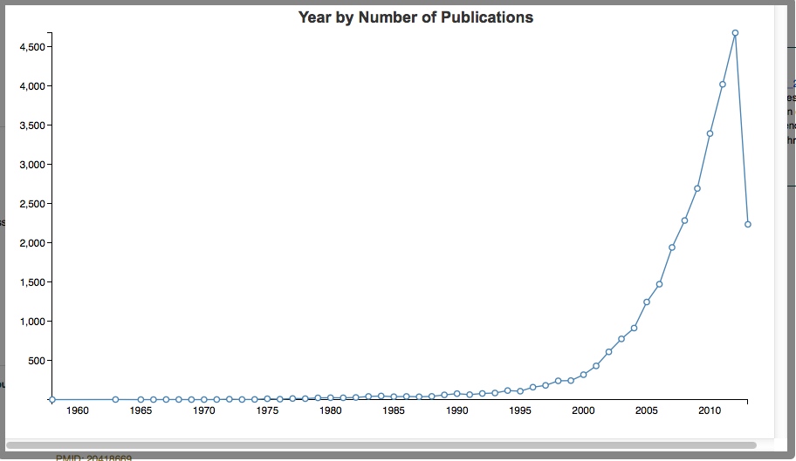
Keeping content up to date
Connectome
New tags come into existence
New resource types come into existence, e.g., Mobile apps
Resources add new types of content
Change name
Change scope
> 7000 updates to the registry last year
Tractography
Epigenetics
It’s a challenge to keep the registry up to date; sitemaps, curation, ontologies, community review

Slide 30
Musings from the NIF
Every resource is resource limited: few have enough time, money, staff or expertise required to do everything they would like
If the market can support 11 MRI databases, fine
Some consolidation, coordination is usually warranted
Big, broad and messy beats small, narrow and neat
Without trying to integrate a lot of data, we will not know what needs to be done
Progressive refinement; addition of complexity through layers
Be flexible and opportunistic
A single optimal technology/container for all types of scientific data and information does not exist; technology is changing
Think globally; act locally:
No source, not even NIF, is THE source; we are all a source
Think about interoperation from the inception

Slide 31
NIF team (past and present)
Fahim Imam
Larry Lui
Andrea Arnaud Stagg
Jonathan Cachat
Jennifer Lawrence
Svetlana Sulima
Davis Banks
Vadim Astakhov
Xufei Qian
Chris Condit
Mark Ellisman
Stephen Larson
Willie Wong
Tim Clark, Harvard University
Paolo Ciccarese
Karen Skinner, NIH, Program Officer (retired)
Jonathan Pollock, NIH, Program Officer
Jeff Grethe, UCSD, Co Investigator, Interim PI
Amarnath Gupta, UCSD, Co Investigator
Anita Bandrowski, NIF Project Leader
Gordon Shepherd, Yale University
Perry Miller
Luis Marenco
Rixin Wang
David Van Essen, Washington University
Erin Reid
Paul Sternberg, Cal Tech
Arun Rangarajan
Hans Michael Muller
Yuling Li
Giorgio Ascoli, George Mason University
Sridevi Polavarum
And my colleagues in Monarch, dkNet, 3DVC, Force 11

